Slide 1
StudyQuest Final Project Presentation
SDEV 265 | Spring 2026 | Leah Osborne
Team Members: Zachary Fike, Cailey Keown, Sean Kennedy, Andrii Kuleshchak, Harold Ligon, and Krystal Michaelis

Slide 2
Project Summary
StudyQuest is a lightweight digital task and habit-tracking planner application.
The purpose of the project was to create a simple, stable productivity tool that allows users to manage tasks, track habits, earn XP, and level up.
The application was designed and developed as a cross-platform academic software project.
The team focused on delivering core functionality, usability, reliability, and successful collaboration within the course timeline.

Slide 3
Project Goals and Objectives
Goal 1: Build a working digital task and weekly planner.
Deliver core features such as task creation, task completion, and weekly organization
Save and load data reliably
Goal 2: Demonstrate the full software development process.
Show planning, design, implementation, testing, and integration in a real team workflow
Goal 3: Deliver a stable cross-platform application on time.
Prioritize reliability over extra features
Ensure the planner works on Windows and macOS
Meet the course deadline

Slide 4
Requirements Summary
The system requirements for StudyQuest included the following:
Users must be able to create tasks with a title and optional notes
Users must be able to edit and delete tasks
Users must be able to mark tasks as complete
Completed tasks must be removed from the active task list
Users must be able to create and manage basic habit entries
Habit entries remain visible after completion
Users must be able to view task completion status
The system must save data when the program closes
The system must load previously saved data when the program starts
The application must be clear, readable, and easy to use
The application must behave consistently across Windows and macOS

Slide 5
Feasibility Study
The project was determined to be feasible in several areas:
Technical Feasibility
The application could be developed using currently available technology
Python and Tkinter were appropriate for the scope of the project
Schedule Feasibility
The scope was manageable within the academic timeline
Core functionality was prioritized first
Economic Feasibility
No additional financial investment was required
Existing hardware and free software tools were used
Operational Feasibility
The application addressed a realistic user need: personal organization and productivity

Slide 6
Project Plan and Risk Assessment
The team created a project plan to organize responsibilities, schedule work, and manage risk.
Major risks identified:
Schedule delays due to school or work obligations
Data loss or save-file failure
Cross-platform issues between Windows and macOS
Performance issues such as slow loading or saving
Scope creep from additional feature requests
Risk mitigation strategies:
Discuss risks during weekly meetings
Prioritize core features before optional features
Test file handling frequently
Test the application on both Windows and macOS
Use GitHub and Discord consistently for communication and coordination

Slide 7
Design Document Highlights
The StudyQuest design document focused on how the application would be built.
The team used a modular architecture with three major areas:
Presentation Layer
Handles the user interface and interaction
Application Logic Layer
Handles tasks, habits, XP calculation, and level progression
Data Persistence Layer
Handles saving and loading user data using file-based storage

Slide 8
UML and System Diagrams
The design phase included several diagrams to support implementation:
Use Case Diagram
Sequence Diagram
Activity Diagram
Class Diagram
Component Diagram

Slide 9
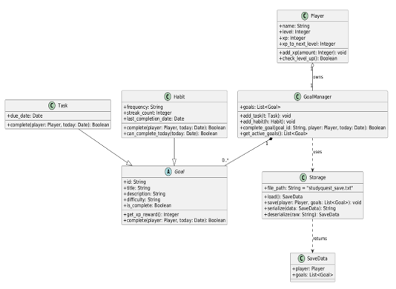
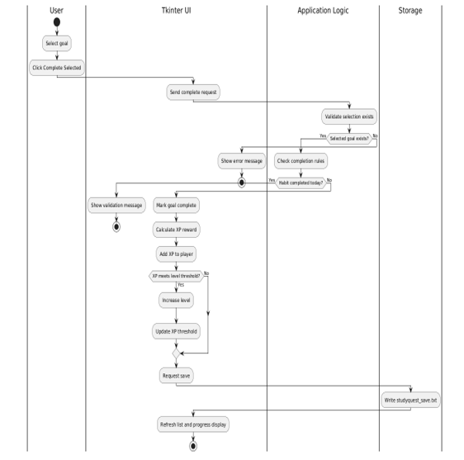
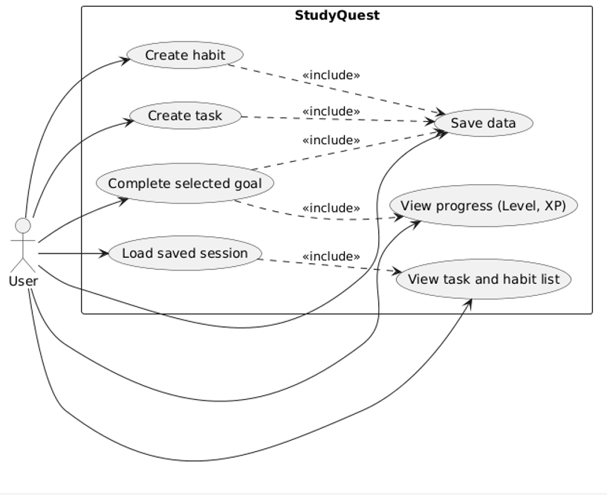
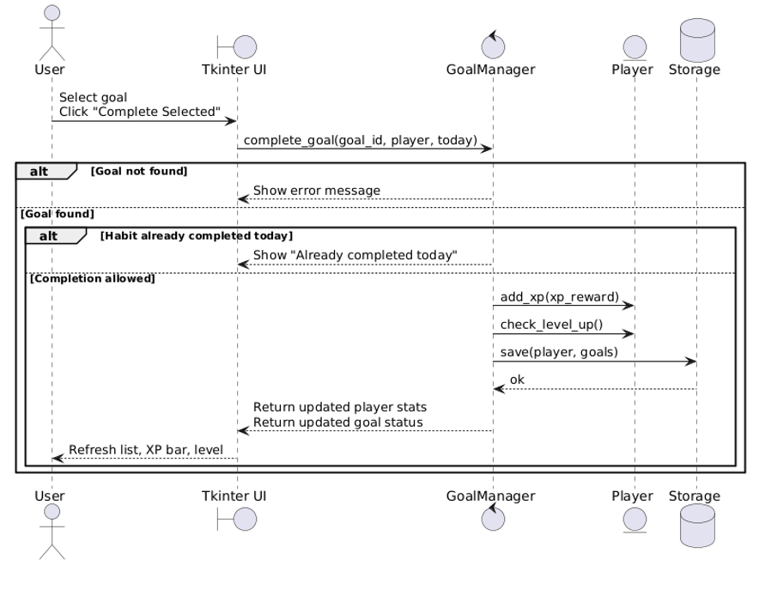
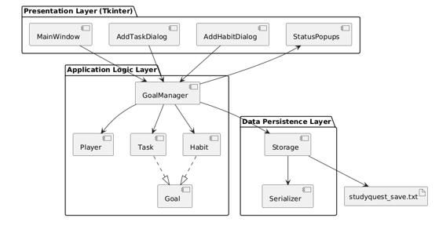

Slide 10




Tools and Technologies Used
The following tools and technologies were used throughout the project:
Python for application development
Tkinter for the desktop graphical user interface
GitHub for version control and collaboration
VS Code / Python development environment for coding
Discord for team meetings and communication
Windows and macOS systems for cross-platform testing
Local file-based storage for saving and loading user data

Slide 11
Running Application
StudyQuest was successfully implemented as a working desktop application.
The final program includes:
Task creation
Habit creation
Goal completion tracking
XP rewards and level progression
Habit streak tracking
Save, load and delete profile functionality
User profile recognition and file persistence

Slide 12
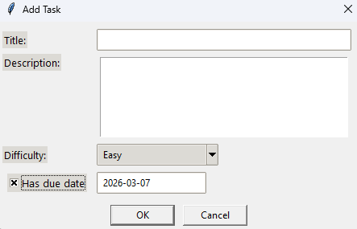
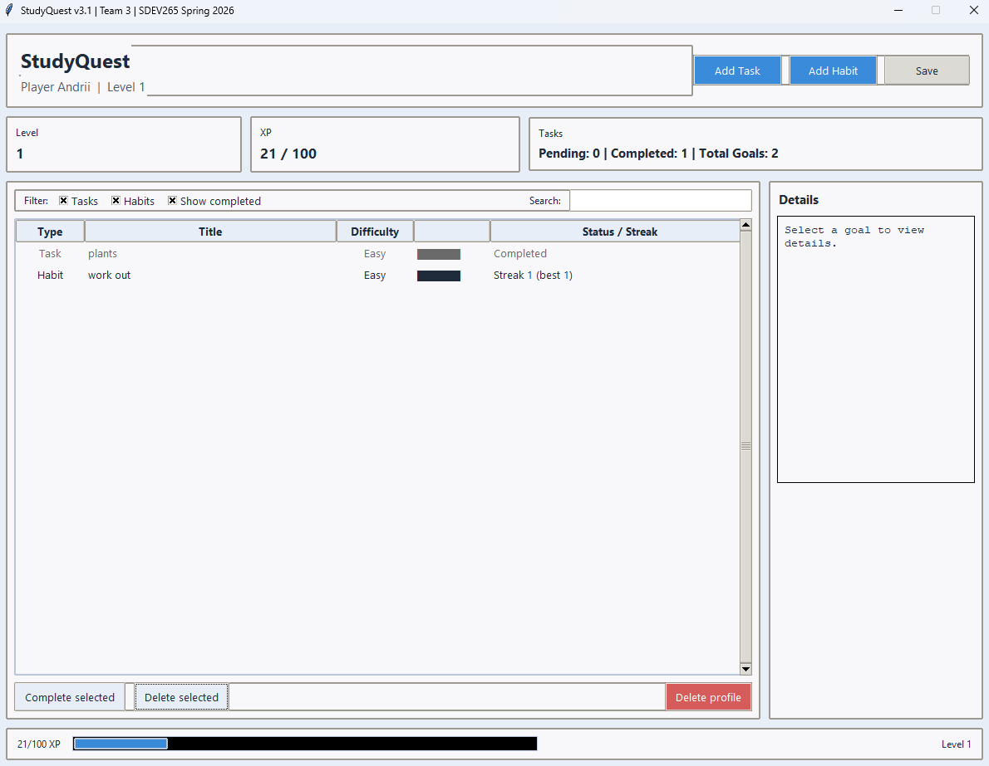
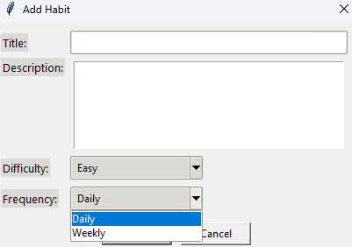
Running Application

Slide 13
Application Component Summary
Successful Implementations
Task creation and completion
Habit creation and streak tracking
XP and level progression
Save/load file functionality
User profile loading
Cross-platform testing
Attempts / Partial Successes
Additional UI polish and visual enhancements
Optional feature ideas such as calendar-related improvements and extra user feedback
Features intentionally limited to protect scope
Advanced feature expansion was reduced to keep the application stable
The team prioritized core functionality and reliability over extra complexity

Slide 14
Future Enhancements
If the project were expanded beyond the course, possible future enhancements could include:
Calendar integration
Notifications and reminders
More visual polish and interface customization
Expanded gamification and reward systems
Cloud synchronization or database storage
Additional user profile features
Improved progress tracking and analytics

Slide 15
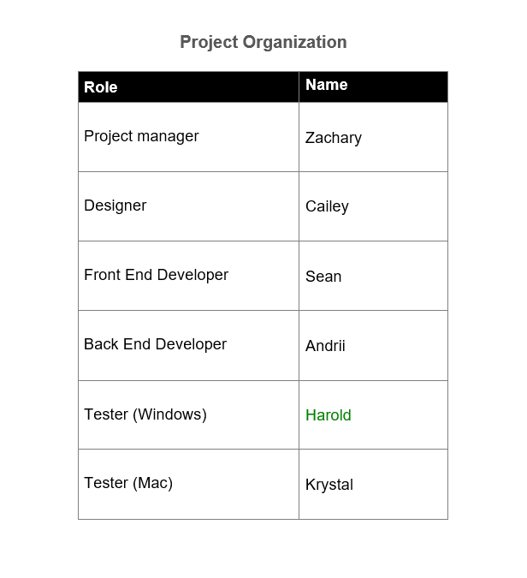

Slide 16
Project Manager Contribution - Zachary Fike
Role: Project Manager
Primary Contributions:
Oversaw planning, scheduling, and task coordination
Helped keep the project on track and aligned with the course timeline
Managed communication and project organization
Supported team collaboration and progress tracking
Helped ensure that scope stayed controlled and core features were prioritized

Slide 17
Designer Contribution - Cailey Keown
Role: Designer
Primary Contributions:
Created the interface layout concept and visual planning for StudyQuest
Helped shape the user interface design and usability direction
Contributed to the software design document and presentation materials
Developed mockups and visual references for the team
Continued attending meetings and supporting documentation efforts throughout the project

Slide 18
Front End Developer Contribution - Sean Kennedy
Role: Front End Developer
Primary Contributions:
Implemented the user interface elements of the StudyQuest application
Connected visual components and user actions to application behavior
Helped build the working layout for tasks, habits, buttons, and status displays
Supported interface functionality such as task creation and goal completion actions
Assisted with refining the appearance and usability of the application

Slide 19
Back End Developer Contribution - Andrii Kuleshchak
Role: Back End Developer
Primary Contributions:
Developed the core logic behind tasks, habits, and goal completion
Implemented XP rewards, level progression, and streak tracking
Built file save and load functionality for user data persistence
Helped ensure the application behaved reliably across sessions
Supported the overall system functionality and feature implementation
macOS Bug Fixes

Slide 20
Windows Tester Contribution - Harold Ligon
Role: Windows Tester
Primary Contributions:
Tested the application on Windows systems
Verified that tasks, habits, XP tracking, and save/load features worked correctly
Helped identify bugs, usability issues, and stability concerns
Supported quality assurance during development and refinement
Confirmed that the application functioned properly on the Windows platform

Slide 21
Mac Tester Contribution - Krystal Michaelis
Role: Mac Tester
Primary Contributions:
Tested the application on macOS systems
Verified that major features worked consistently across platforms
Helped identify platform-specific issues and cross-platform concerns
Supported testing of usability, stability, and core functionality
Confirmed that StudyQuest performed reliably on macOS

Slide 22
Questions?
Thank you for viewing our presentation on StudyQuest.
If you have any questions about the project, design process, or development, we would be happy to answer them.
Team 3 – StudyQuest
SDEV 265 | Spring 2026

